Slide 1

Senate Environmental Resources and Energy Committee
Glen Thomas
April 28. 2026

Slide 2
Energy Prices– 2022-24 Average Retail Rates
New York – 18.33 cents/kwh (2022)
18.28 cents/kwh (2023)
19.66 cents/kwh (2024)
New Jersey – 14.80 cents/kwh (2022)
15.27 cents/kwh (2023)
16.29 cents/KWH (2024)
Maryland – 13.32 cents/kwh (2022)
14.24 cents/kwh (2023)
15.04 cents/kwh (2024)
Pennsylvania – 11.86 cents/kwh (2022)
12.57 cents/kwh (2023)
12.51 cents/kwh (2024)
Ohio – 10.64 cents/kwh (2022)
11.04 cents/kwh (2023)
11.29 cents/kwh (2024)
National Average - 12.36 cents/kwh (2022)
12.68 cents/kwh (2023)
12.94 cents/kwh (2024)
Source: https://www.eia.gov/electricity/state/

Slide 3
Total Power Production– 2022-24
Pennsylvania – 239 million MWHs (2022)
235 million MWHs (2023)
241 million MWHs (2024)
Illinois – 185 million MWHs (2022)
177 million MWHS (2023)
185 million MWHs (2024)
Ohio – 135 million MWHs (2022)
133 million MWHs (2023)
142 million MWHs (2024)
New Jersey – 65 million MWHs (2022)
64 millions MWHs (2023)
60 million MWHs (2024)
National Total - 4.23 billion MWHs (2022)
4.18 billion MWHs (2023)
4.30 billion MWHs (2024)
Source: https://www.eia.gov/electricity/annual/html/epa_03_07.html
Maryland – 37 million MWHs (2022)
36 million MWs (2023)
35 million MWHs (2024)

Slide 4
Electric Power Production and Consumption by State (2024)
State | Total Production (MWh) | Total Consumption (MWh)
Maryland | 35,424,816 | 59,018,688
New Jersey | 60,175,245 | 73,531,424
Pennsylvania | 241,498,648 | 142,146,514
Ohio | 142,747,706 | 153,707,376

Slide 5
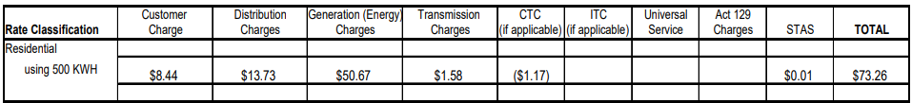
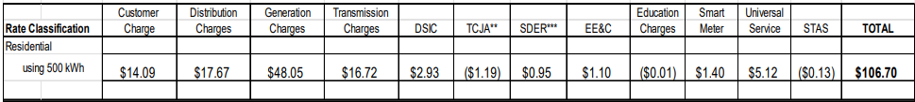
PPL Residential Rates – 2010 vs 2026 Source - https://www.puc.pa.gov/filing-resources/reports/rate-comparison-reports
2010
2026

Slide 6
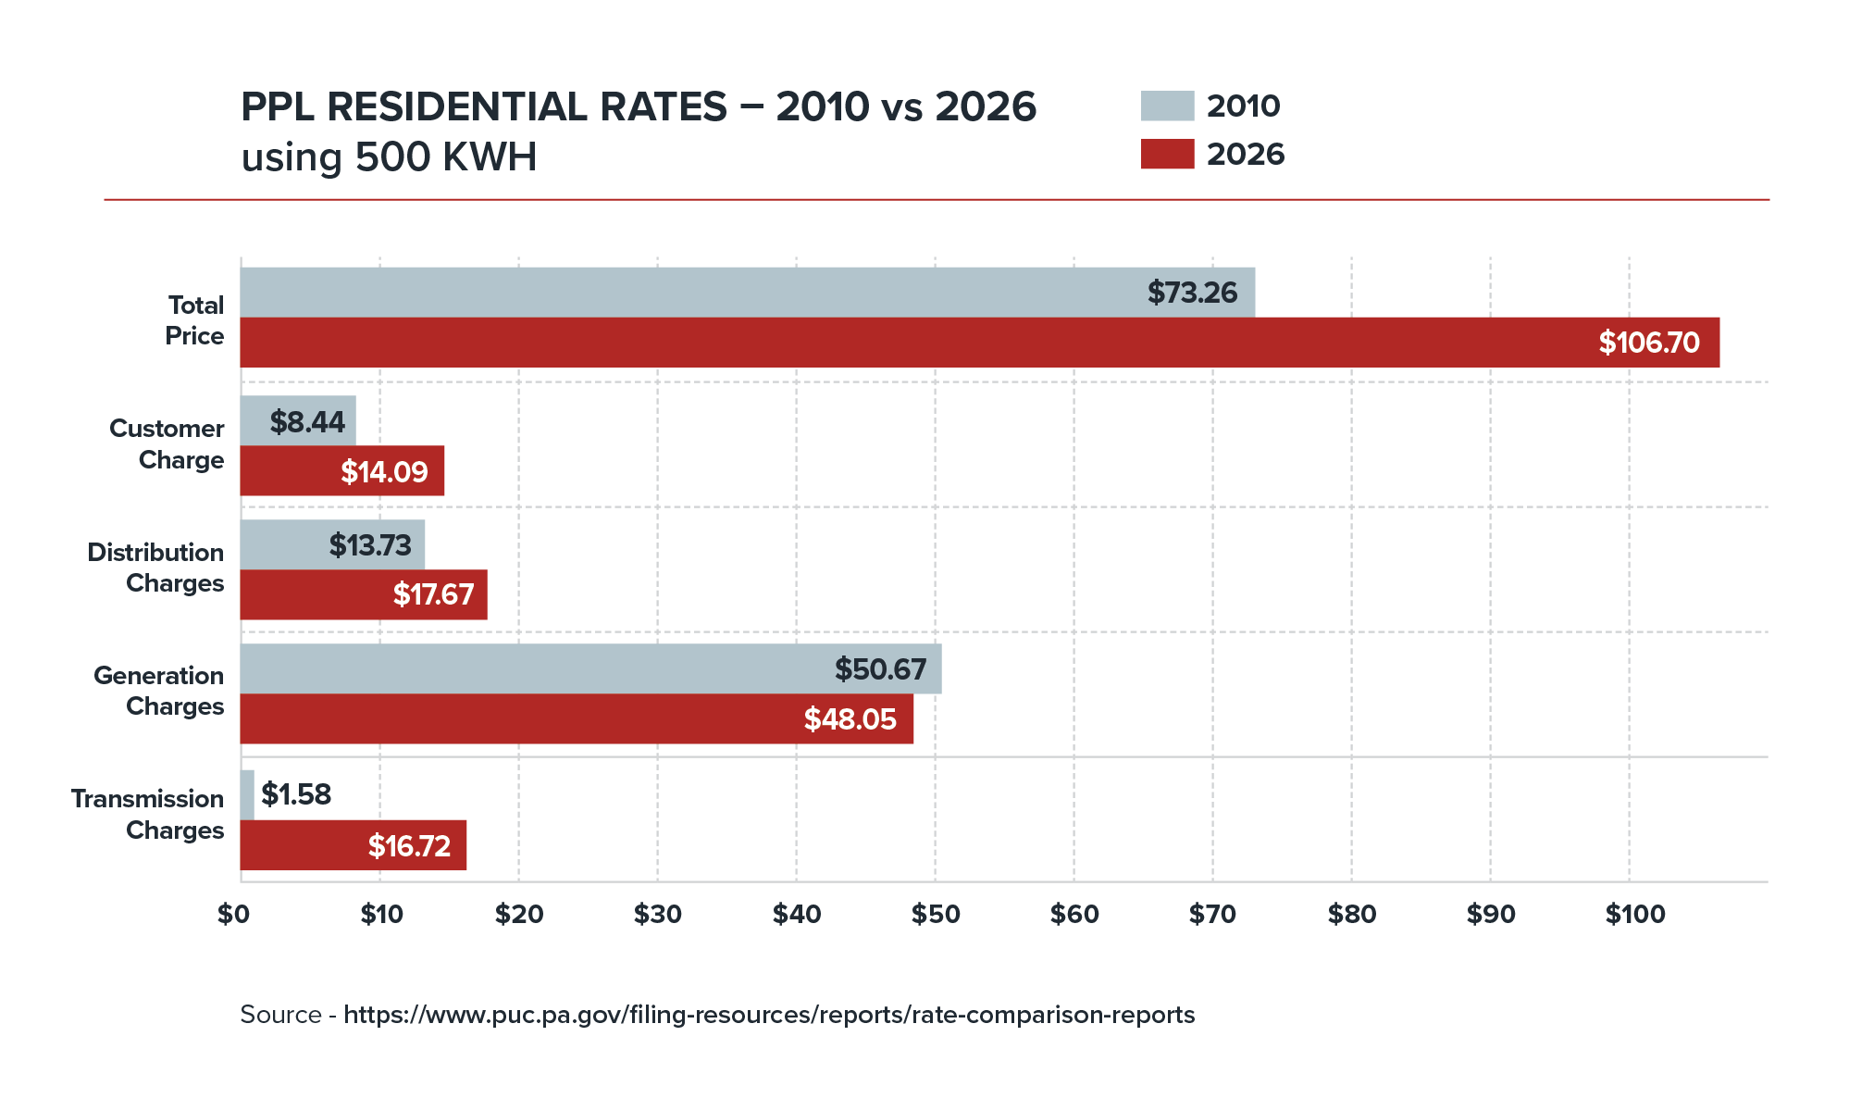

Slide 7
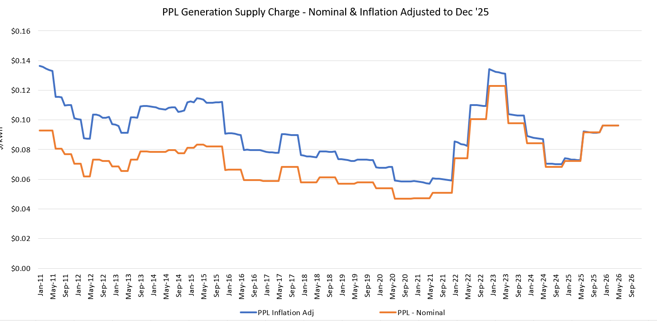
PPL Historical Default Generation Rates

Slide 8
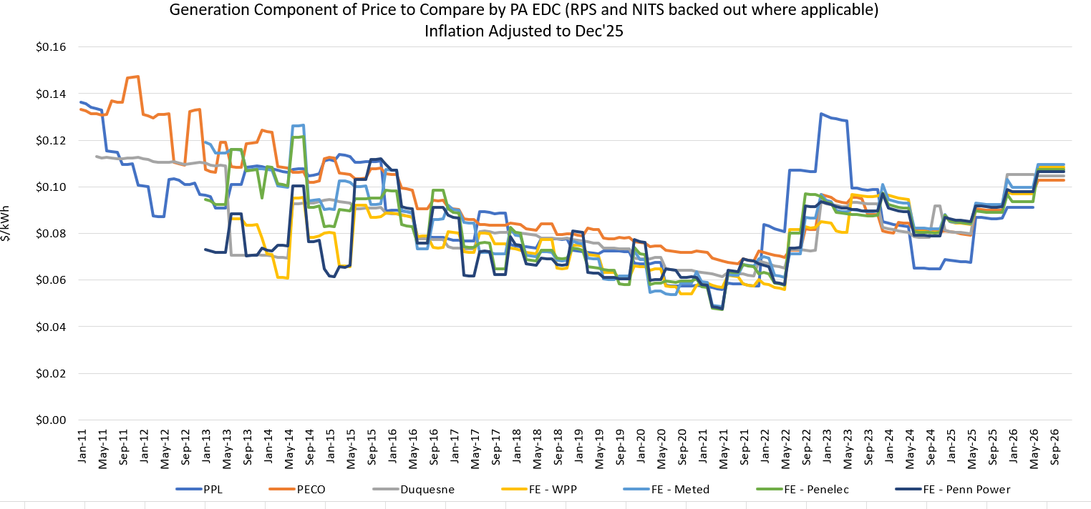
Pennsylvania Historical Default Generation Rates

Slide 9
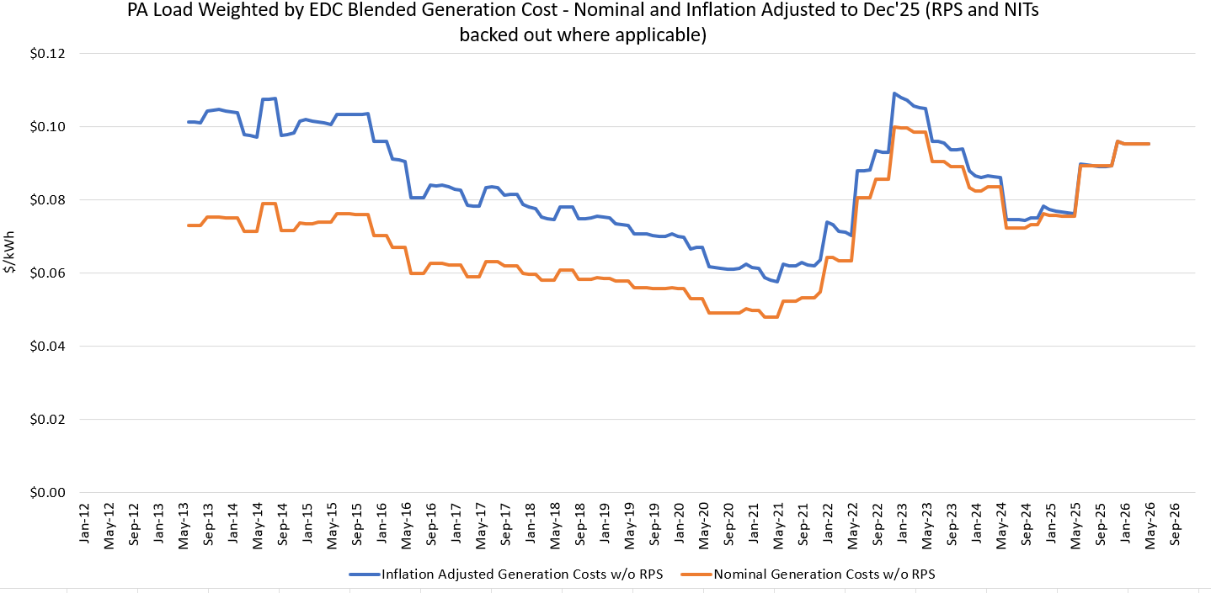
Pennsylvania Historical Default Generation Rates - Blended

Slide 10
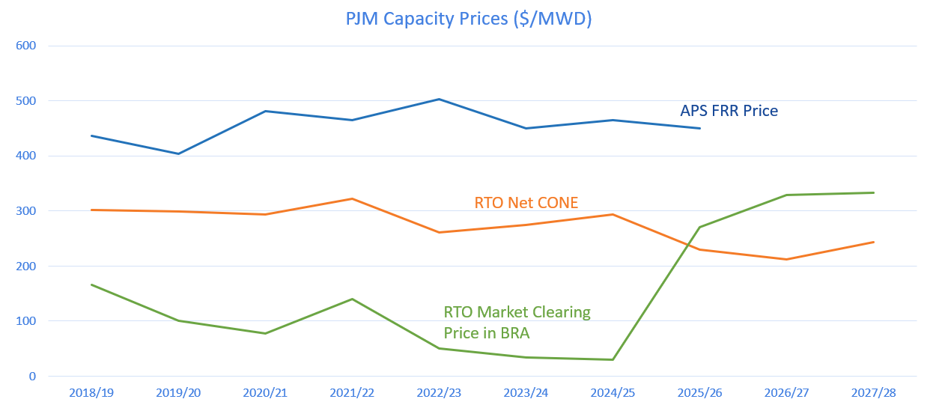
Capacity Market Prices Since 2018

Slide 11
PJM’s Capacity Auctions
23/24 $34/Mwday, 21.6% Reserve Margin
24/25 $28/Mwday, 21.7 Reserve Margin
25/26 $270/MWday, 18.6% Reserve Margin
26/27 $329/Mwday, 18.9% Reserve Margin
27/28 $333/Mwday, 14.4% Reserve Margin (likely to be adjusted up to 17% in Feb 2027)
28/29 – Auction to be held in July 2026
29/30 – Auction to be held in December 2026
30/31 Auction to be held in May 2027

Slide 12
The Market in PA is Responding
Crane Clean Energy Center (restart of TMI-1) 835 MWs (approx.) Nuclear Constellation Energy Dauphin Co. 2024-09-20 Restart of TMI-1; ~$1.6B; COD 2027
Limerick Clean Energy Uprate 340 MWs Nuclear (uprate) Constellation Energy Montgomery Co. 2025-07-15 Extends life into 2040s
Homer City Energy Campus 4,500 MWs (approx.) Gas (7x GE 7HA.02) Ho Homer City Redev. Indiana Co. 2025-04-02 4.5 GW redevelopment
Shippingport Power Station 2,700 MWs (approx.) Gas (NGCC) Frontier Group Beaver Co. 2025-07-16 Repurposing Bruce Mansfield site
Greene County BTM Gas Plant (IEP III) 944 MWs Gas CCGT + BESS IEP III / Essential Utilities Greene Co. 2025-08-27 Behind-the-meter; data center
PPL–Blackstone JV TBD Gas (multi-CCGT) PPL & Blackstone Multiple sites 2025-07-15 ESA-backed; 2030s
Armstrong Plant Conversion (LS Power) 300 MWs (approx.) Gas (CCGT conv.) LS Power Armstrong Co. 2025-03-14 Conversion to baseload CCGT
Hummel Uprate (Capital Power) 40 MWs Gas (uprate) LS Power Snyder Co. 2025-03-14 Incremental uprate
Hunterstown Uprate (LS Power) 30 MWs Gas (uprate) LS Power Adams Co. 2025-03-14 Incremental uprate
SW PA Natural Gas Generation Facility 4,300 MWs Gas NextEra Energy Resources SW PA 2026-03-20 Approximately a $17 billion project

Slide 13
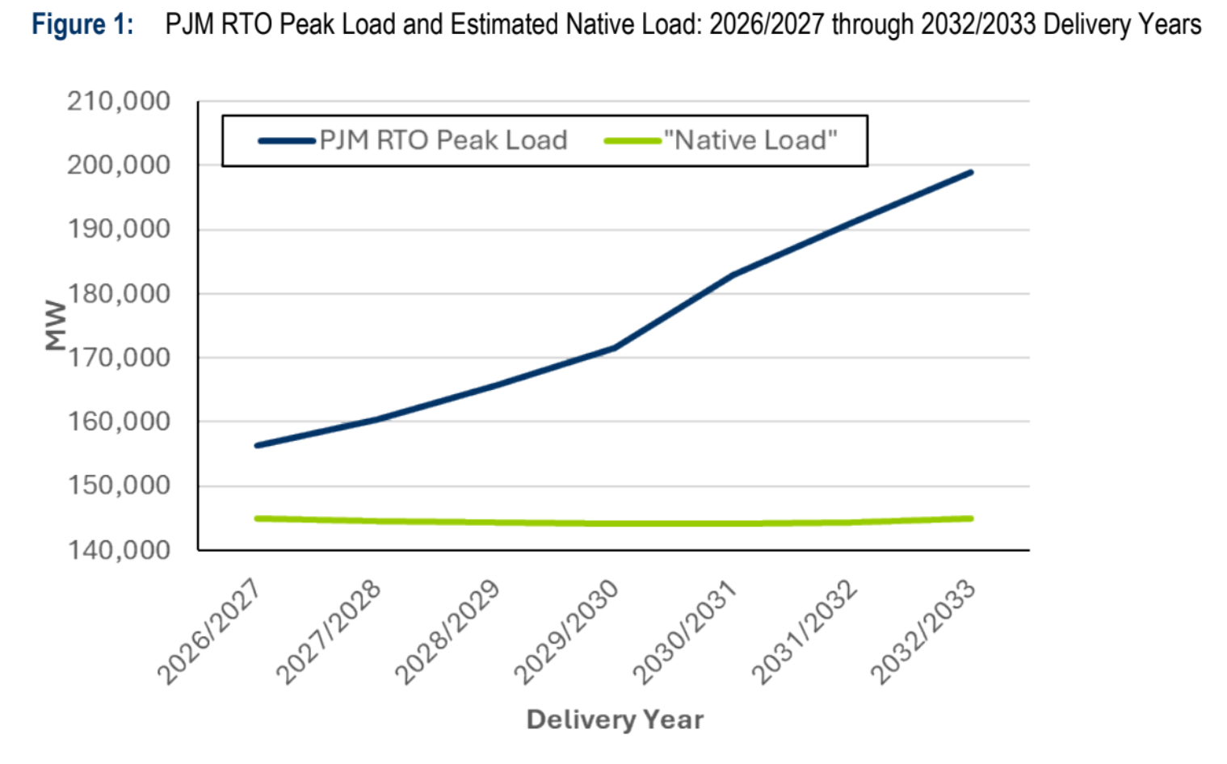
The Data Center Dilemma

Slide 14
The Data Center Dilemma
Non-data center demand growth is essentially flat.
Data center load has proven difficult to predict – timing issues, load shape, etc.
Bipartisan support has emerged for data centers to bring their own generation as part of the interconnection process.
PJM is working on a Reliability Backstop mechanism to procure the generation shortfall and assign the costs to new large loads.

Slide 15
The Load Forecast Challenge
PJM is highly dependent on information provided by the utilities.
Discussions between data centers and utilities are shielded by NDAs.
Actual demand is showing up significantly below projected demand.
When the demand forecast is too high, consumers pay too much and reliability challenges are overstated.
The PA Load Forecast Accountability Act (passed in Nov) must be effectively implemented.
PJM’s current reforms will likely put significant pressure on utilities to get load forecast correct.

Slide 16
PJM Reliability Backstop Proposal
PJM released a Reliability Backstop Proposal on April 10.
From September 2026 to March 2027, PJM is going to encourage large loads to sign bilateral contracts with large loads and load serving entities.
If there is still a shortfall in March 2027, PJM will procure capacity for utilities and assign the costs to those utilities who are short capacity.
A FERC filing is anticipated in June.
PJM issued an RFI on April 16th.

Slide 17
Bring Your Own New Generation (BYONG) and Connect and Manage
At the direction of the White House and the Governors in the PJM Footprint, PJM is developing rules that require new large loads to bring their own new generation to the market.
Large loads that do not bring their own new generation will be subject to “Connect and Manage” which allow data centers to interconnected to the grid but will subject them to curtailment under peak conditions.
PJM expects to make a filing in early fall.

Slide 18
What Should Pennsylvania do?
Stay committed to the competitive market design that has proved to be enormously successful.
Facilitate state level permitting to allow power plants to come online more quickly.
Support PJM’s efforts to structure wholesale markets to support Pennsylvania’s competitive retail model.
Restructure state level utility tariffs to properly assign costs to new large loads and manage EDC risk. Legislation may be needed to align with PJM reforms.
Load Forecast Accountability Act may need updating.
Require PA utilities to be in RTOs via legislation.

