Slide 1
PJM: Maintaining Resource Adequacy
During a Period of Transition
Pennsylvania Senate – Joint Hearing
Consumer Protection & Professional Licensure Committee
Environmental Resources & Energy Committee
Jason Stanek
Executive Director, Governmental Services
May 12, 2025

Slide 2


Slide 3
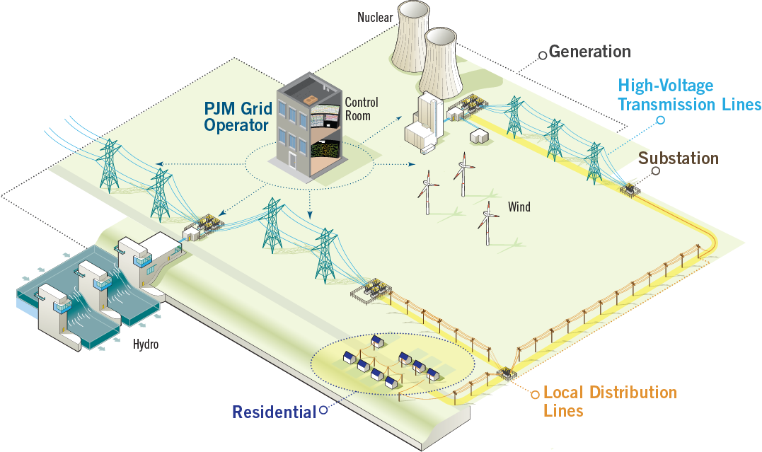
Power Delivery

Slide 4
What Is a Regional Transmission Organization?
An independent entity that is responsible for:
Operating competitive wholesale markets | Safe and reliable operation of regional power grid | Ensuring competitive open access to transmission where no member or member group has undo influence
An RTO owns no transmission or generation assets and has no financial interest in the wholesale market or in any of the market participants

Slide 5
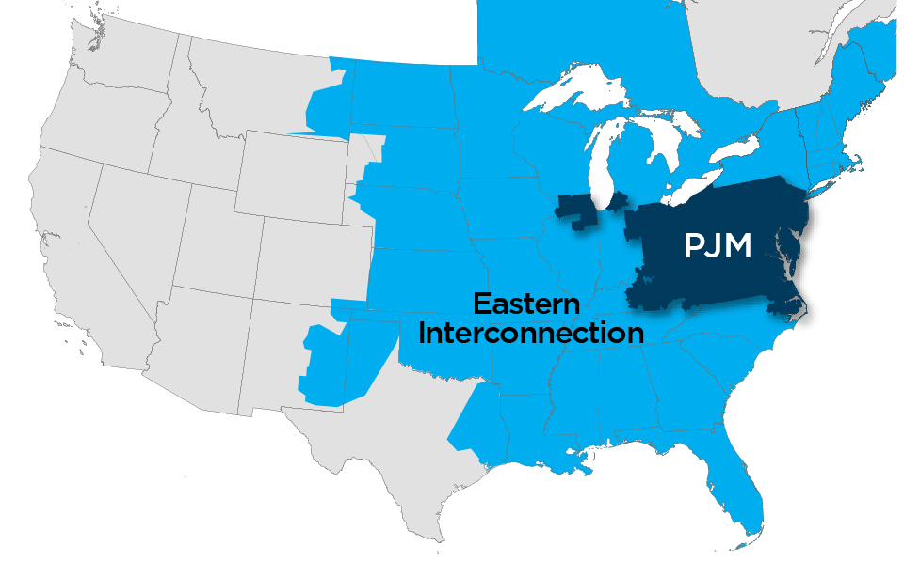
PJM as Part of the Eastern Interconnection
Key Statistics
Member companies | 1,110
Millions of people served | 67+
Peak load in megawatts | 165,563
Megawatts of generating capacity | 182,036
Miles of transmission lines (BES) | 88,333
Gigawatt hours of annual energy | 800,004
Generation sources | 1,486
Square miles of territory | 369,054
States served | 13 + DC
27% of generation in Eastern Interconnection
24% of load in Eastern Interconnection
As of 2/2025

Slide 6
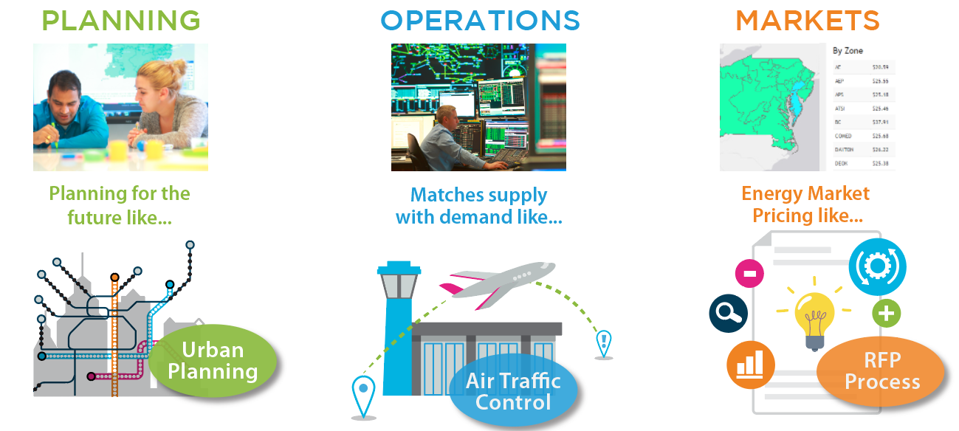
PJM’s Role as a Regional Transmission Organization

Slide 7

Capacity vs. Energy
Capacity | Product:
A commitment of a resource to provide energy, particularly during PJM emergencies Capacity revenues paid to committed resource whether or not energy is produced by resource. | Daily
Energy
Generation of electrical power over a period of time Energy revenues paid to resource based on participation in PJM’s Day-Ahead & Real-Time Energy markets | Hourly
Capacity
Energy
Think of capacity like a parking lot. A business includes enough parking to accommodate customers at its busiest times, but on a typical day, many spaces remain empty.
Capacity, energy & ancillary services revenues are expected, in the long term,
to provide generation resources with the opportunity to recover fixed and variable costs
to ensure that adequate generation is maintained for reliability of the electric grid.

Slide 8
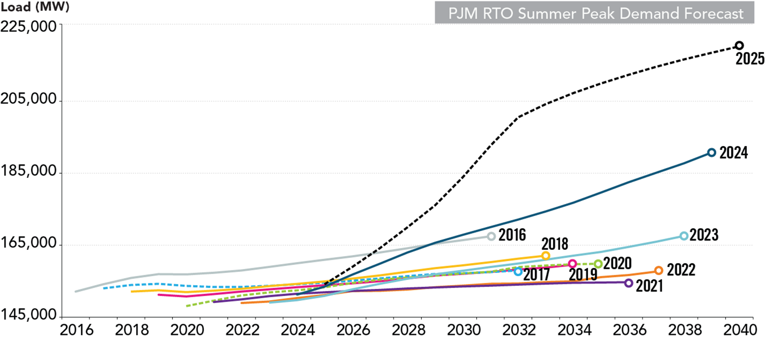
Electricity Demand Growth

Slide 9
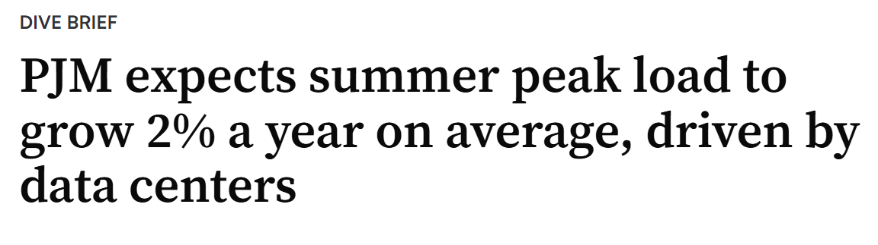
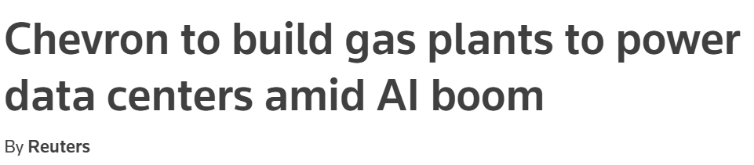
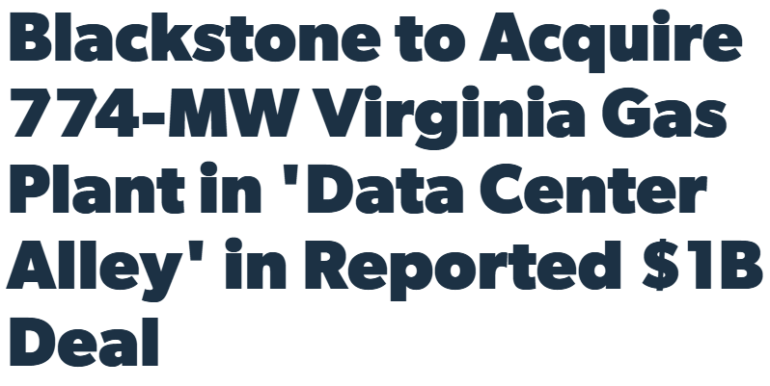
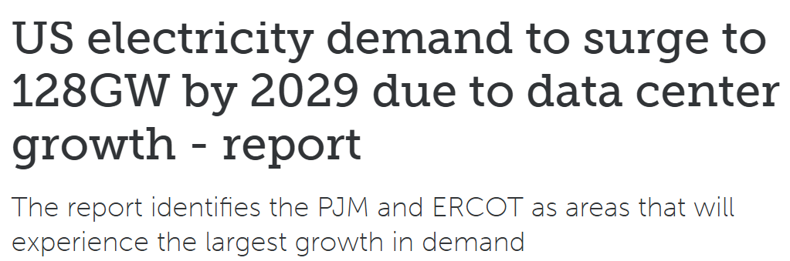
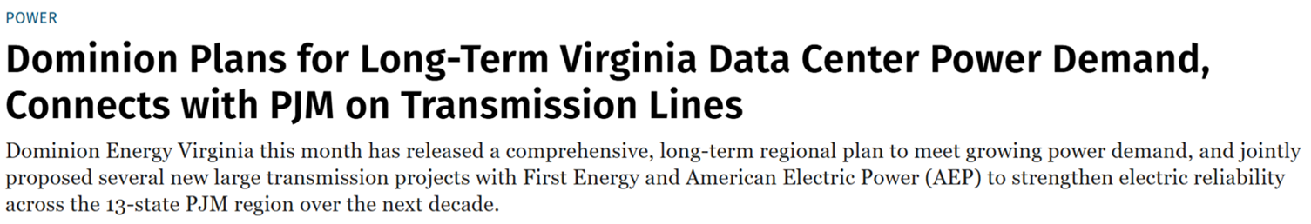
Data Center Proliferation

Slide 10
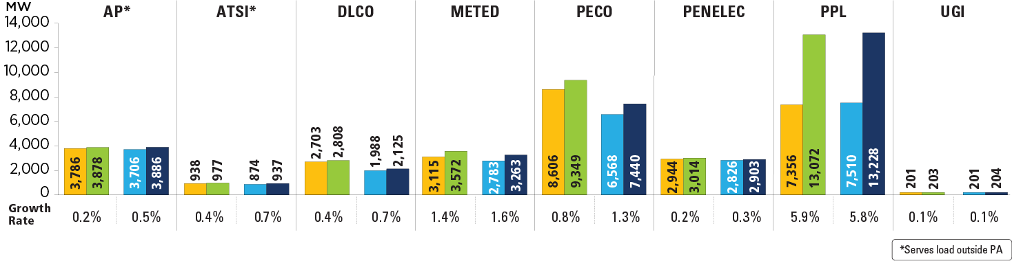
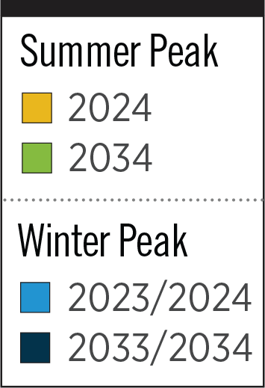
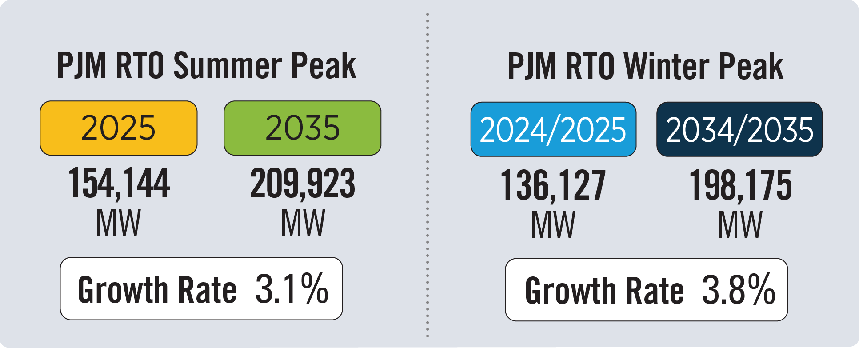
PA – 2025 Load Forecast Report
The summer and winter peak megawatt values reflect the estimated amount of forecast load to be served by each transmission owner in the noted state/district. Estimated amounts were calculated based on the average share of each transmission owner’s real-time summer and winter peak load in those areas over the past five years.

Slide 11
Large Load Adjustments (MWs)

Slide 12
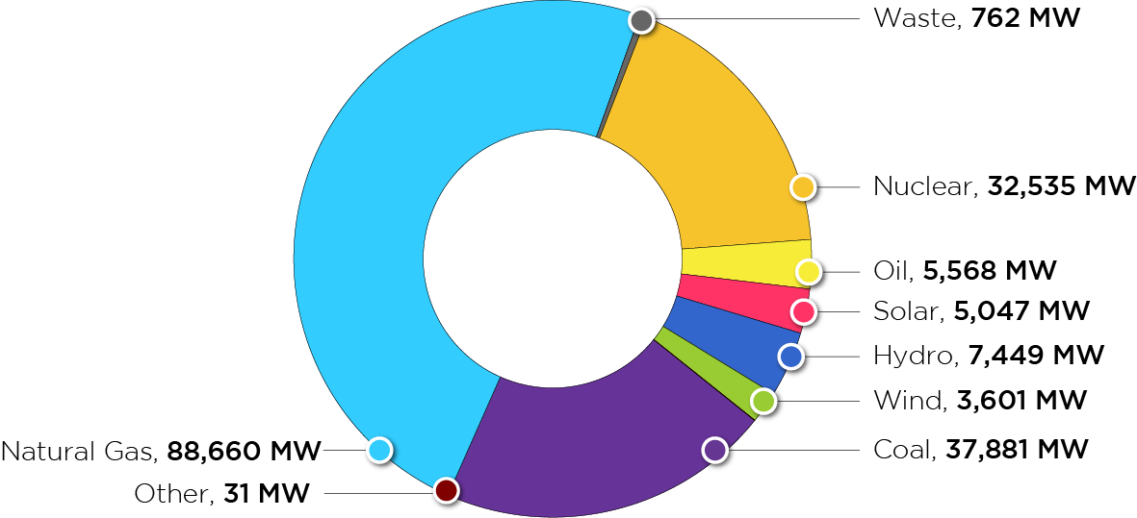
PJM Existing Installed Capacity Mix
(CIRs – as of Dec. 31, 2024)
PJM
181,534
MW

Slide 13
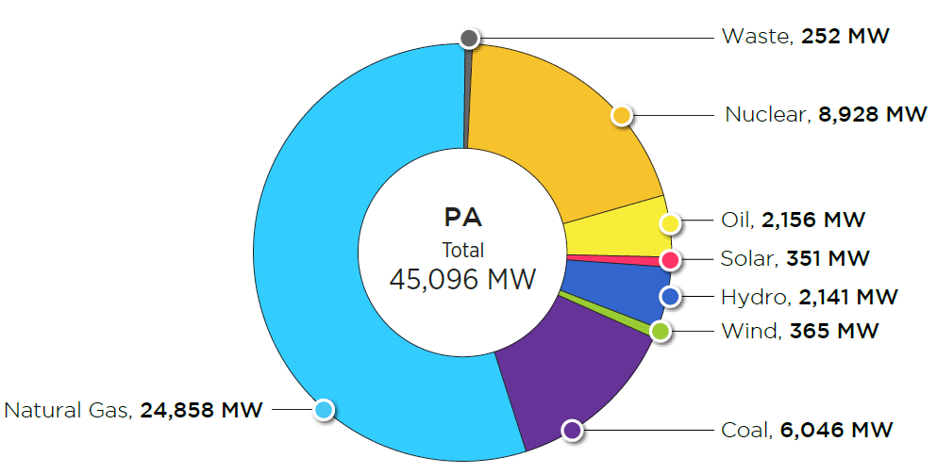
Pennsylvania – Existing Installed Capacity (MW) by Fuel Type
(as of Dec. 31, 2024)

Slide 14
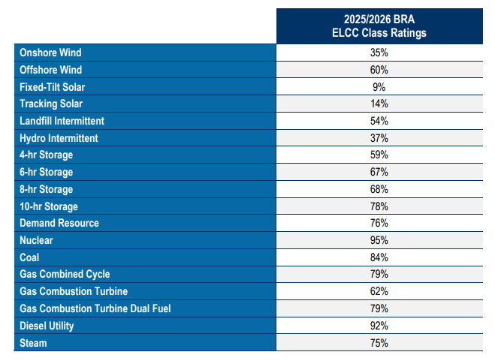
ELCC Ratings – “What Can You Do For Reliability?”
Enhance reliability risk modeling in resource adequacy studies.
Improve capacity accreditation to reflect resources’ contribution during periods of risk.
Maintain the capacity performance framework, but enhance the rules and testing requirements.
Improve other areas of the market construct, including balanced market power mitigation rules.*
The following table provides the ELCC Class Ratings applicable to the 2025/2026 Base Residual Auction (BRA) as calculated under the methodology approved by FERC on January 30th, 2024 in FERC Docket No. ER24-99
*Market Power Mitigation changes in ER24-98 were not accepted by FERC.

Slide 15
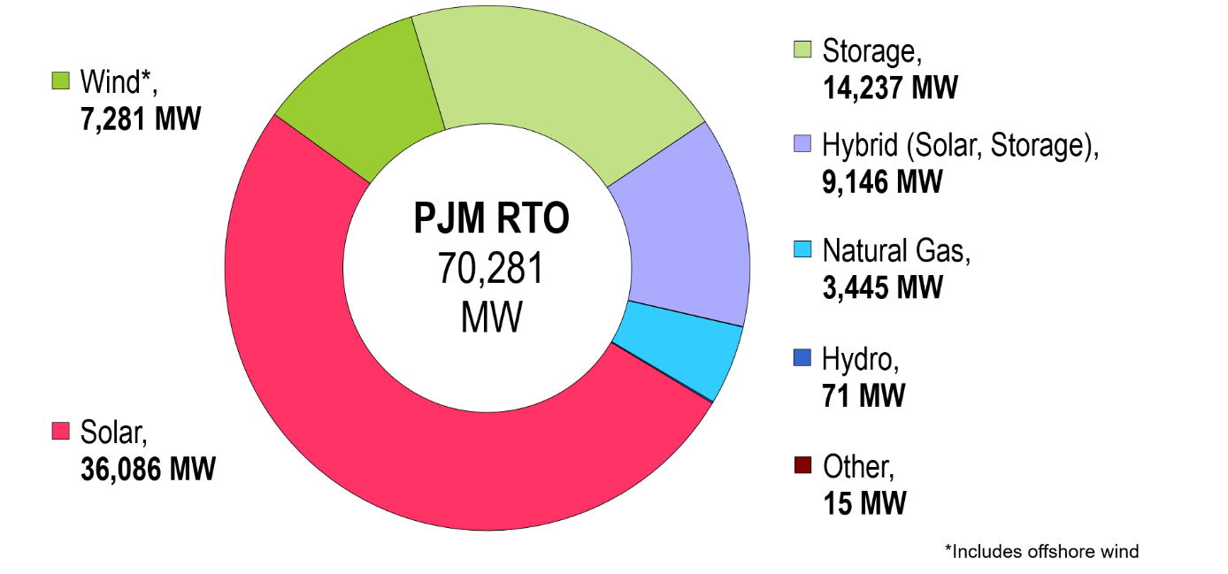
PJM Queued Capacity (Nameplate) by Fuel Type
(“Active” in the PJM Queue as of Mar. 11, 2025)

Slide 16
Pennsylvania Queued Capacity (Nameplate) by Fuel Type
(“Active” in the PJM Queue as of April 1, 2024)

Slide 17
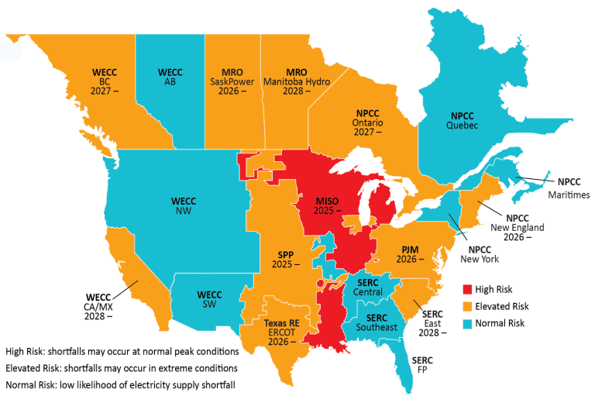
NERC: Long-Term Reliability Assessment
Graphic: NERC

Slide 18
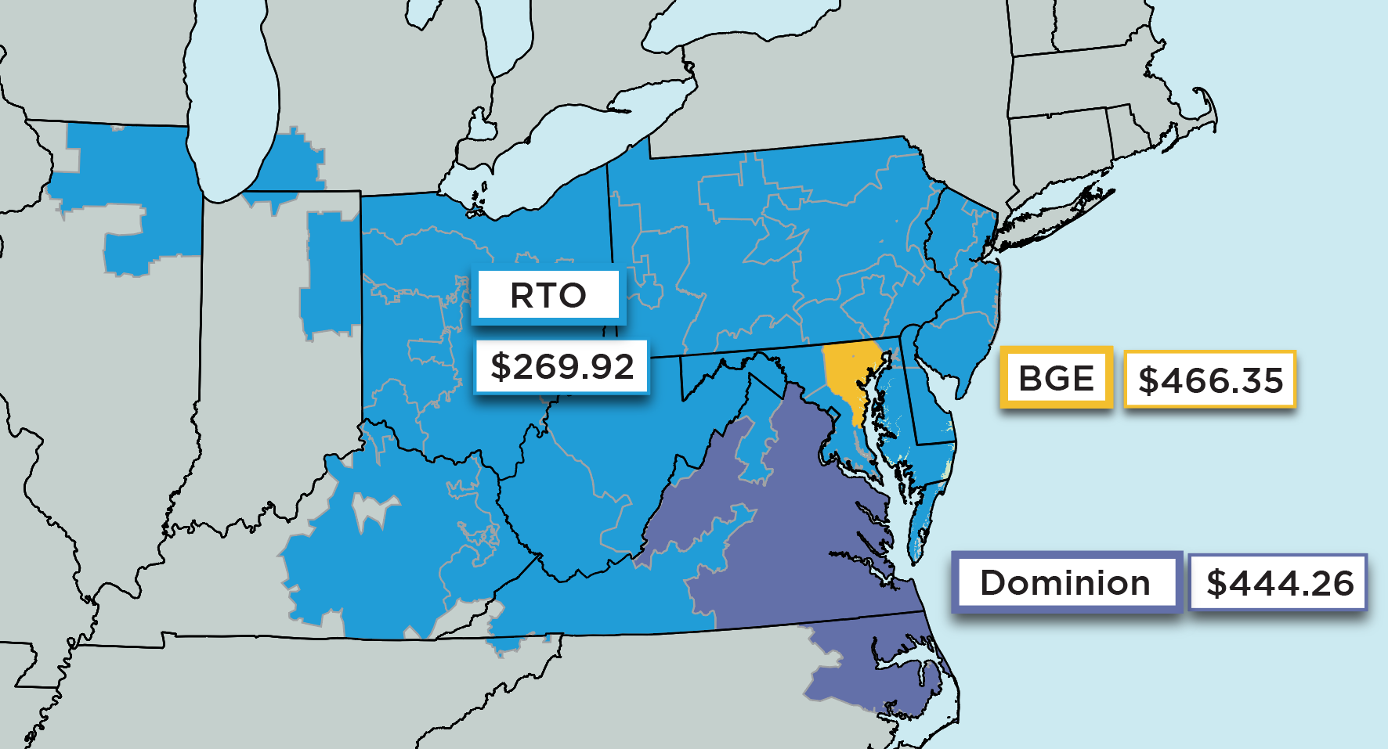
RTO & LDA Prices
RTO Price Comparison
 | 2025/2026 | 2024/2025
RTO Price: | $269.92/ MW-day | $29/ MW-day
Reserve Margin with IRM of: | 18.5% | 20.5%
 | 17.8% | 14.7%

Slide 19
Governor Shapiro’s Complaint
On December 30, 2024 Governor Shapiro’s office filed a complaint against PJM at the Federal Energy Regulatory Commission (FERC)
The complaint alleged that the capacity auction price cap would be too high given a lower expectation for new generation entry in the near-term
Prior to the compliant, PJM and Governor Shapiro’s office held several meeting to discuss PJM’s capacity auction
Shortly after the compliant was filed, PJM and Governor Shapiro’s office entered into confidential settlement discussions

Slide 20
Settlement Terms and FERC Approval
PJM and Governor Shapiro’s office agreed in principle to a price cap and floor for the 2026/27 and 2027/28 capacity auctions
  Price cap ~ $325/MW-day
  Price floor ~ $175/MW-day
The above agreed upon values are based on an assumed accreditation of a dual fuel CT of 79%
The settlement agreement was approved by FERC on April 21.

Slide 21
PJM Efforts to Expedite Supply
CIR Transfer | Target: New generation resources swapping-in for a deactivating generator that then don’t need to go through queue
 | Potential Outcome: Permanent modifications to the process
Reliability Resource Initiative
Reliability Resource Initiative | Target: Queue opened for new shovel-ready resources that can come online quickly and contribute to reliability
 | Potential Outcome: One-time expansion of the eligibility criteria for Transition Cycle #2 beyond active requests received prior to September 2021
Surplus Interconnection Service | Target: Making it easier to add more generation to an existing site for generators that are not able to operate continually 24/7/365 (e.g. adding storage to renewable site)
 | Potential Outcome: Permanent modification to Surplus Interconnection Service criteria

Slide 22
RRI - All Projects by State
 | Number | Nameplate | CIR
Delaware
Illinois | 4 | 398 | 313
Indiana
Kentucky | 1 | 786 | 759
Maryland | 2 | 554 | 548
Michigan
North Carolina
New Jersey | 5 | 550 | 607
Ohio | 9 | 3,363 | 3,242
Pennsylvania | 7 | 1,201 | 1,293
Tennessee
Virginia | 22 | 5,095 | 5,309
West Virginia | 1 | 0 | 14
Total | 51 | 11,945 | 12,085

Slide 23
RRI Projects - Pennsylvania
Fuel | Number | Nameplate | CIR
Coal
Natural Gas | 5 | 342 | 470
Nuclear | 1 | 859 | 803
Storage
Wind | 1 | 0 | 20
Total | 7 | 1,201 | 1,293
Queue | County | Fuel | Type | Nameplate | CIR
AH1-695 | Dauphin | Nuclear | New | 859 | 803
AH1-697 | Lackawanna | Nat gas | Uprate | 39 | 79
AH1-705 | Snyder | Nat gas | Uprate | 32 | 32
AH1-707 | Lycoming | Nat gas | Uprate | 0 | 30
AH1-720 | Bradford | Nat gas | Uprate | 0 | 60
AH1-734 | Indiana | Nat gas | Uprate | 270 | 269
AH1-746 | Clearfield | Wind | Uprate | 0 | 20

Slide 24
Policy Takeaways
States should avoid policies intended to push existing generation resources off of the system until an adequate quantity of replacement generation is online and has been shown to be operating
States should help to bring new generation resources onto the system as soon as possible
States should address state and local challenges in the siting/permitting of all electricity infrastructure including transmission infrastructure
Consider consumer cost increases as a natural byproduct of policies that exacerbate the supply/demand imbalance.

