Slide 1
Pennsylvania and Ohio: Regional Dynamics and Future Reliability
Glen Thomas
November 2, 2023

Slide 2
What is PJM?

Slide 3
Energy Prices– 2022 Average Retail Rates
New York – 18.33 cents/kwh
New Jersey – 14.80 cents/kwh
Maryland – 13.32 cents/kwh
Pennsylvania – 11.86 cents/kwh
Ohio – 10.64 cents/kwh
National Average - 12.36 cents/kwh
Source: https://www.eia.gov/electricity/annual/html/epa_02_10.html

Slide 4
Total Power Production– 2022
Pennsylvania – 229 million MWHs
Illinois – 185 million MWHs
Ohio – 135 million MWHs
New Jersey – 65 million MWHs
National Total - 4.2 billion MWs
Source: https://www.eia.gov/electricity/annual/html/epa_03_07.html
Maryland – 37 million MWHs

Slide 5
Net Generation from Renewable Energy (excluding Hydro)– 2022
Pennsylvania – 5.4 million MWHs
Ohio – 4.6 million MWHs
Illinois – 25.3 million MWHs
New Jersey – 2.2 million MWHs
National Total - 646 million MWs
Source: https://www.eia.gov/electricity/annual/html/epa_03_15.html
Maryland – 1.5 million MWHs

Slide 6
Net Generation from Natural Gas– 2022
Pennsylvania – 130.1 million MWHs (2021 – 126.6 million)
Ohio – 68.8 million MWHs (2021 - 56.3 million)
Illinois – 19.7 million MWHs
New Jersey – 33.4 million MWHs
National Total - 1.68 billion MWHs
Source: https://www.eia.gov/electricity/annual/html/epa_03_15.html
Maryland – 13.9 million MWHs

Slide 7
Net Generation from Coal– 2022
Pennsylvania – 23.9 million MWHs (2021 – 29.3 million)
Ohio – 43 million MWHs (2021 – 45.6 million)
Illinois – 40.5 million MWHs (2021 – 43.2 million)
New Jersey – 498,000 MWHs (2021 – 1,026,000)
National Total - 831.5 million MWHs (2021 – 898 million)
Source: https://www.eia.gov/electricity/annual/html/epa_03_08.html
Maryland – 4.6 million MWHs (2021 – 5.2 million)

Slide 8
Net Generation from Nuclear – 2022
Pennsylvania – 76.1 million MWHs
Ohio – 16.8 million MWHs
Illinois – 98.8 million MWHs
New Jersey – 28.3 million MWHs
National Total - 771.5 million MWHs (2021 – 897,999)
Source: https://www.eia.gov/electricity/annual/html/epa_03_13.html
Maryland – 14.8 million MWHs

Slide 9
State Policy - New Jersey
On Feb 15, 2023, Governor Murphy declared state’s policy to provide for 100% of the electricity sold in the State to be derived from “clean” sources by January 1, 2035. NJ BPU was ordered by the Governor to develop plan in 2024.
New Jersey defines “100% clean energy by 2050” to mean 100% carbon-neutral electricity generation. Carbon-neutrality means having a net zero carbon footprint by eliminating carbon emissions or balancing carbon emissions with carbon removal.
New Jersey's nuclear units (3500 MW), that are directly competing with PA and Ohio nuclear units, are receiving a subsidy of $300 million through at least 2025.
On September 21, 2022, Governor Murphy signed Executive Order #307, increasing New Jersey’s offshore wind goal by nearly 50 percent to 11,000 megawatts (MW) by 2040
New Jersey has a goal of 2000 MWs of energy storage by 2030 (financing has yet to be determined)

Slide 10
State Policy - Maryland
Maryland will require that 50% of electricity consumed in the state be from renewable energy resources by 2030.
Maryland has contracted for 2000 MWs of offshore wind and Governor Moore has a stated goal of 8500 MWs of offshore wind.
Governor Moore has set a goal of 100% “clean” energy by 2035.

Slide 11
State Policy - Illinois
Illinois will require all private coal and natural gas-fired units to reach zero emissions by either 2030, 2035 or 2045, depending on ownership, location and rates of emissions.
Policy of state is to be 100% “clean” by 2050.
State goal is to be 50% renewable by 2040.
Illinois will provide $700 million through 2026 to subsidize nuclear facilities in the state.
Illinois will provide $580 million a year to support wind and solar development.

Slide 12
PJM Market Trends
Demand is rising faster than historic rates.
Retirements are happening faster than anticipated - PJM projects that 20% of its existing capacity will retire between now and 2030 – approximately 40 GW
Replacement capacity is not of the quality and quantity necessary to sustain reliability.
As a result, at the current trajectory, PJM is not going to have sufficient power to meet the demands of consumers and prices are likely to increase.

Slide 13
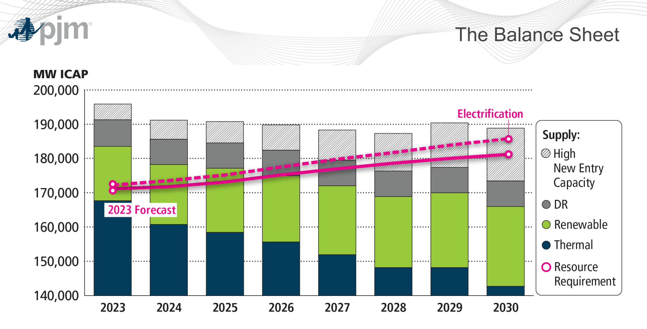

Slide 15
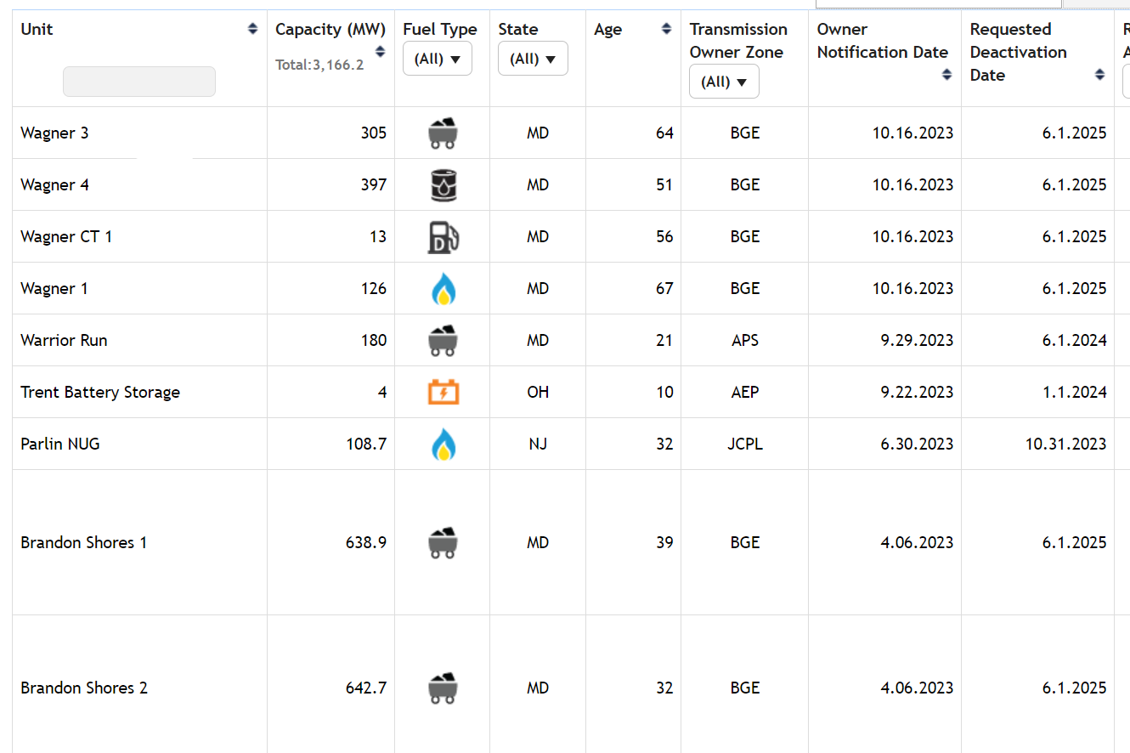
Recent Deactivation Notices
.

Slide 16
Brandon Shores Retirement
Brandon Shores is a 1300 MW Coal Plant Located in Maryland in a Constrained Region of the Grid.
In April, Talen announced it would retire the plant in 2025.
The retirement results in “nearly 600 reliability violations.”
PJM’s studies revealed the need for $785 million in transmission upgrades to bring more power into the region.
Transmission upgrades will not be completed until the end of 2028.
Maryland is protesting charges at FERC.

Slide 17
Historically Low Capacity Prices

Slide 18
PJM and FERC Decisions/ Events
Repeal of Minimum Offer Price Rule (2019)
Imposition of onerous Capacity Market Seller Offer Caps (2021)
Revised Capacity Market Demand Curve Parameters that discourage investment (2023)
Change of rules in the middle of an auction to get a desired result (2023)
Winter Storm Elliot (2022)

Slide 19
What will reverse the current trend?
PJM and FERC must change capacity market rules to encourage the retention of existing resources that are needed for reliability and the development of new resources.
Federal and state policymakers make decisions that support and do not undermine reliability.
Federal and state policymakers must consider reliability when developing environmental regulations.
Interconnection queue reform.

Slide 20
PJM’s October 13 Capacity Market Reform Filing
PJM made a series of proposed reforms to the capacity market in a FERC filing on October 13.
The reforms address important areas such as generator performance, resource accreditation, market mitigation and risk modelling.
FERC has 60 days from date of filing to issue and order or find the filing deficient.
Next capacity auction is currently scheduled from June 2024 for the delivery year from June 1, 2025, to May 31, 2026.

Slide 21
Capacity Accredidation
Accreditation is the process by which PJM evaluates a resource’s ability to meet the capacity needs of the system.
PJM currently does “average” accreditation, but the October 13 filing moves to “marginal” accreditation.
Moving to marginal accreditation should provide a more realistic evaluation of the capacity contributions of new resources.
Significant questions remain regarding accreditation of gas resources.

Slide 22
Capacity Market Offer Restrictions
Prior to September 2021, generators could submit bids into the capacity market up to the Net Cost of New Entry.
In September 2021, FERC, granted a complaint of the PJM Market Monitor, that said generators could offer into the capacity market at their going forward costs.
Generators have struggled with a new regime in which they do not have independent ability to offer into the market their costs and risks.
The PJM Oct 13 filing improves but does not fix this issue.

Slide 23
What’s next?
Reliability challenges are likely to get worse, not better.
Capacity market reforms must continue. The work is not done, and trend will not reverse itself until the economics for generators improve.
Reserve pricing conversation is important.
Pressure PJM, PUC and FERC to make decisions that support Pennsylvania and Ohio’s competitive model which use competitive markets to drive reliability.
Stay engaged and be vocal!

